Slide 1
Interim 1
-- BPS5231 AI for Sustainable Building Design
Kefan Chen, Guanli Feng
Oct 6, 2025

Slide 2
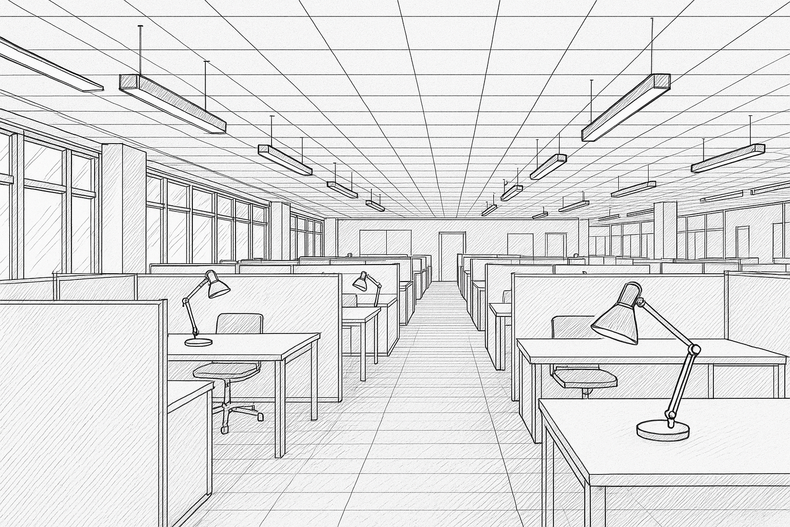
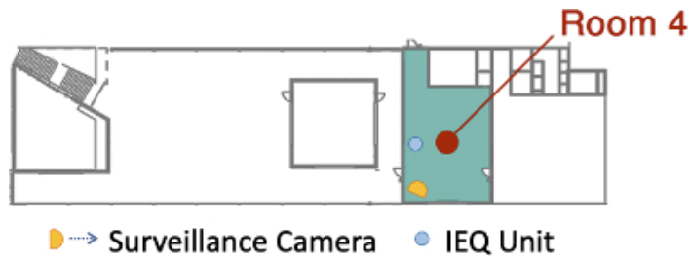
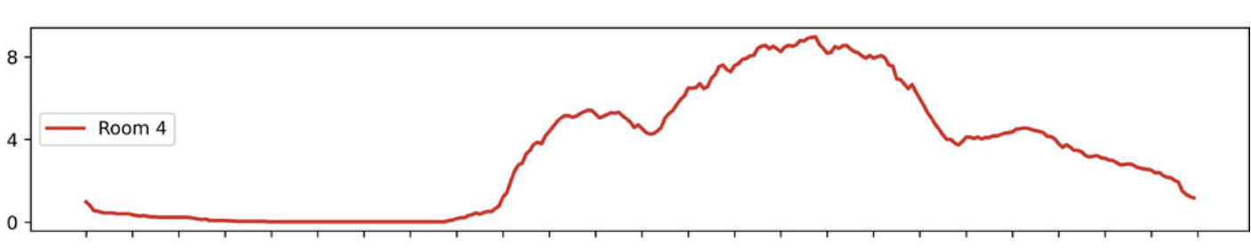
Problem Description
Modern buildings mainly rely on center background systems
While Personalized Environmental Control Systems (PECS) allow individuals to customize indoor individual micro-environment.
Problem Identification
Background system –> general space control PECS –> micro-environment of occupants
➡️ But occupants come and leave ➡️ If there's a better controlling strategy corresponding to changing occupancy condition?
Research Question/Hypothesis
1 > Optimization on light control and energy: Under different occupant distribution conditions, could we design an integrated framework that combines PECS and background system control on lighting to maintain/improve occupants' visual light comfort and save lighting energy consumption?
2 > Case study on real occupancy historical data of BEE Hub: Could we utilize ML tools (like surrogate model thinking) to apply such control strategy on different occupant distribution in an accurate and low time-consuming way? Then we could combine it with historical occupancy data to visualize its energy saving potential.
GPT5-generated diagram
Tekler, Z.D., Ono, E., Peng, Y. et al. ROBOD, room-level occupancy and building operation dataset. Build. Simul. 15, 2127–2137 (2022). https://doi.org/10.1007/s12273-022-0925-9

Slide 3
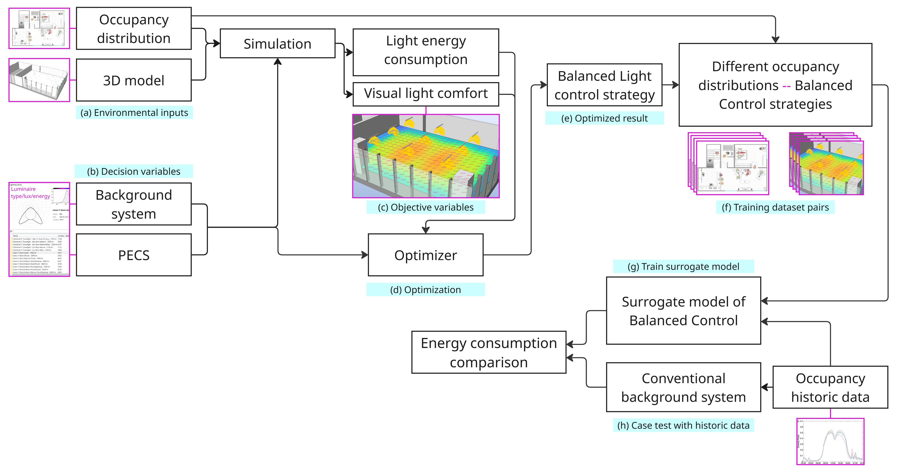
Exploratory Data Analysis & Potential Method – Optimize control strategy, Create Dataset, Train surrogate model, Apply to physical case

Slide 4
Exploratory Data Analysis & Potential Method – Optimize control strategy, Create Dataset, Train surrogate model, Apply to physical case

Slide 5
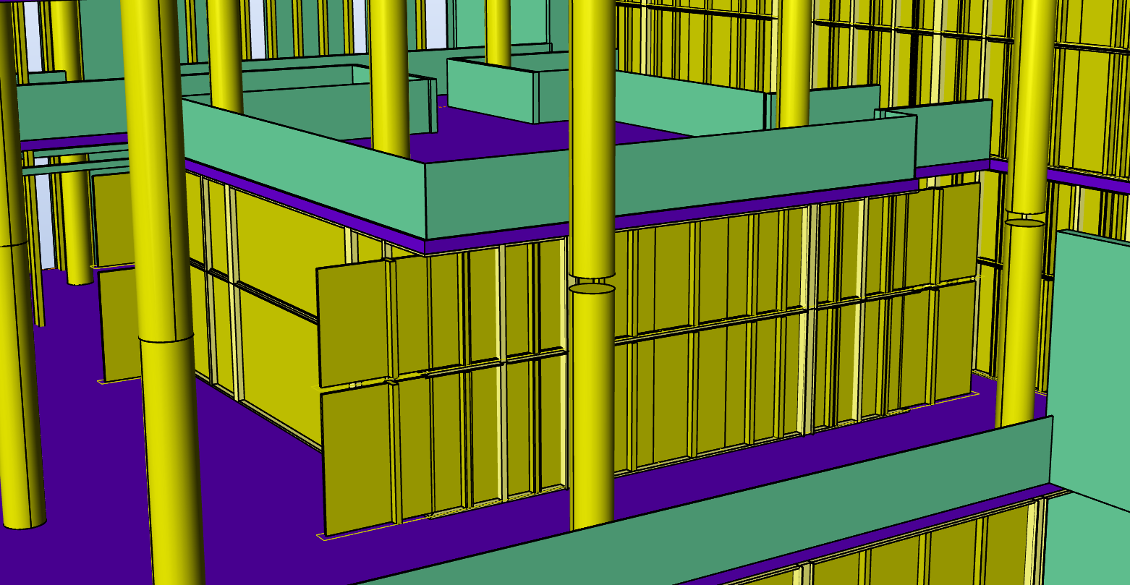
Exploratory Data Analysis & Potential Method – Optimize control strategy, Create Dataset, Train surrogate model, Apply to physical case
(a) Environmental inputs of BEE Hub
Occupancy distribution: Randomly generate occupant distribution on designed seats (max possibility= 2^n, n = seats available)
3D model: Rhino space model of field case - BCA MMV Living Lab
Tekler, Z.D., Ono, E., Peng, Y. et al. ROBOD, room-level occupancy and building operation dataset. Build. Simul. 15, 2127–2137 (2022). https://doi.org/10.1007/s12273-022-0925-9
BEE Hub model from Rhino3d

Slide 6
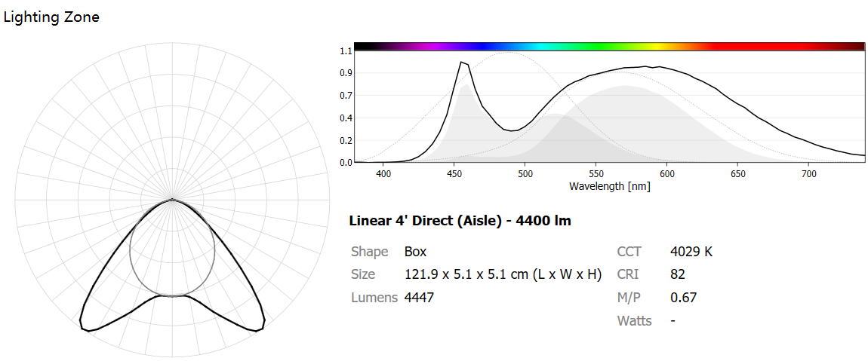
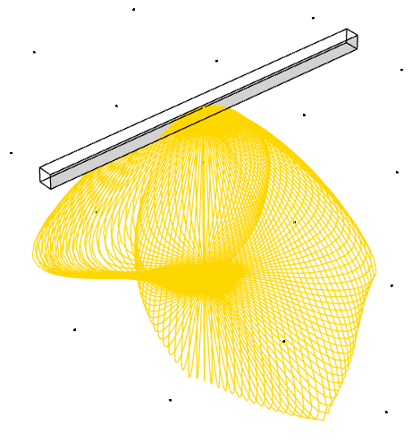
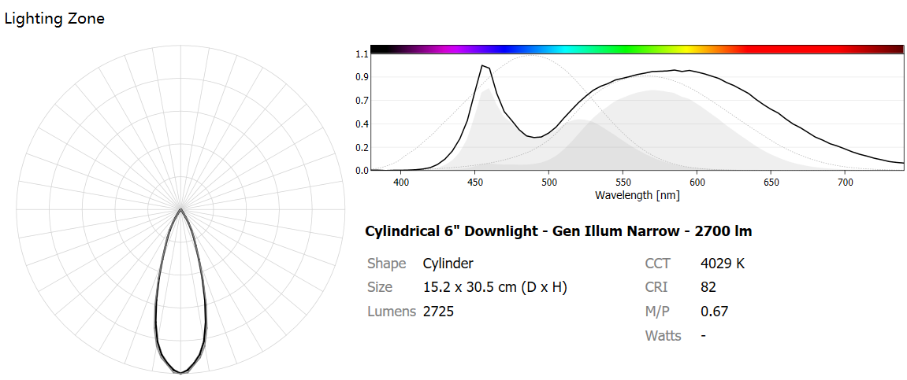
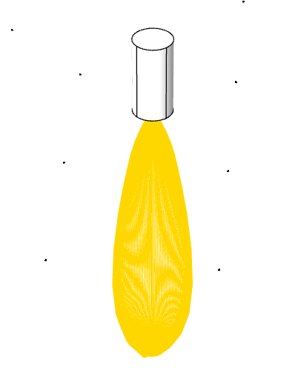
Exploratory Data Analysis & Potential Method – Optimize control strategy, Create Dataset, Train surrogate model, Apply to physical case
(b) Decision variables
Background system & PECS of light (luminaire): Electric inputs - the type/power/luminance/layout of them (TBD)

Slide 7
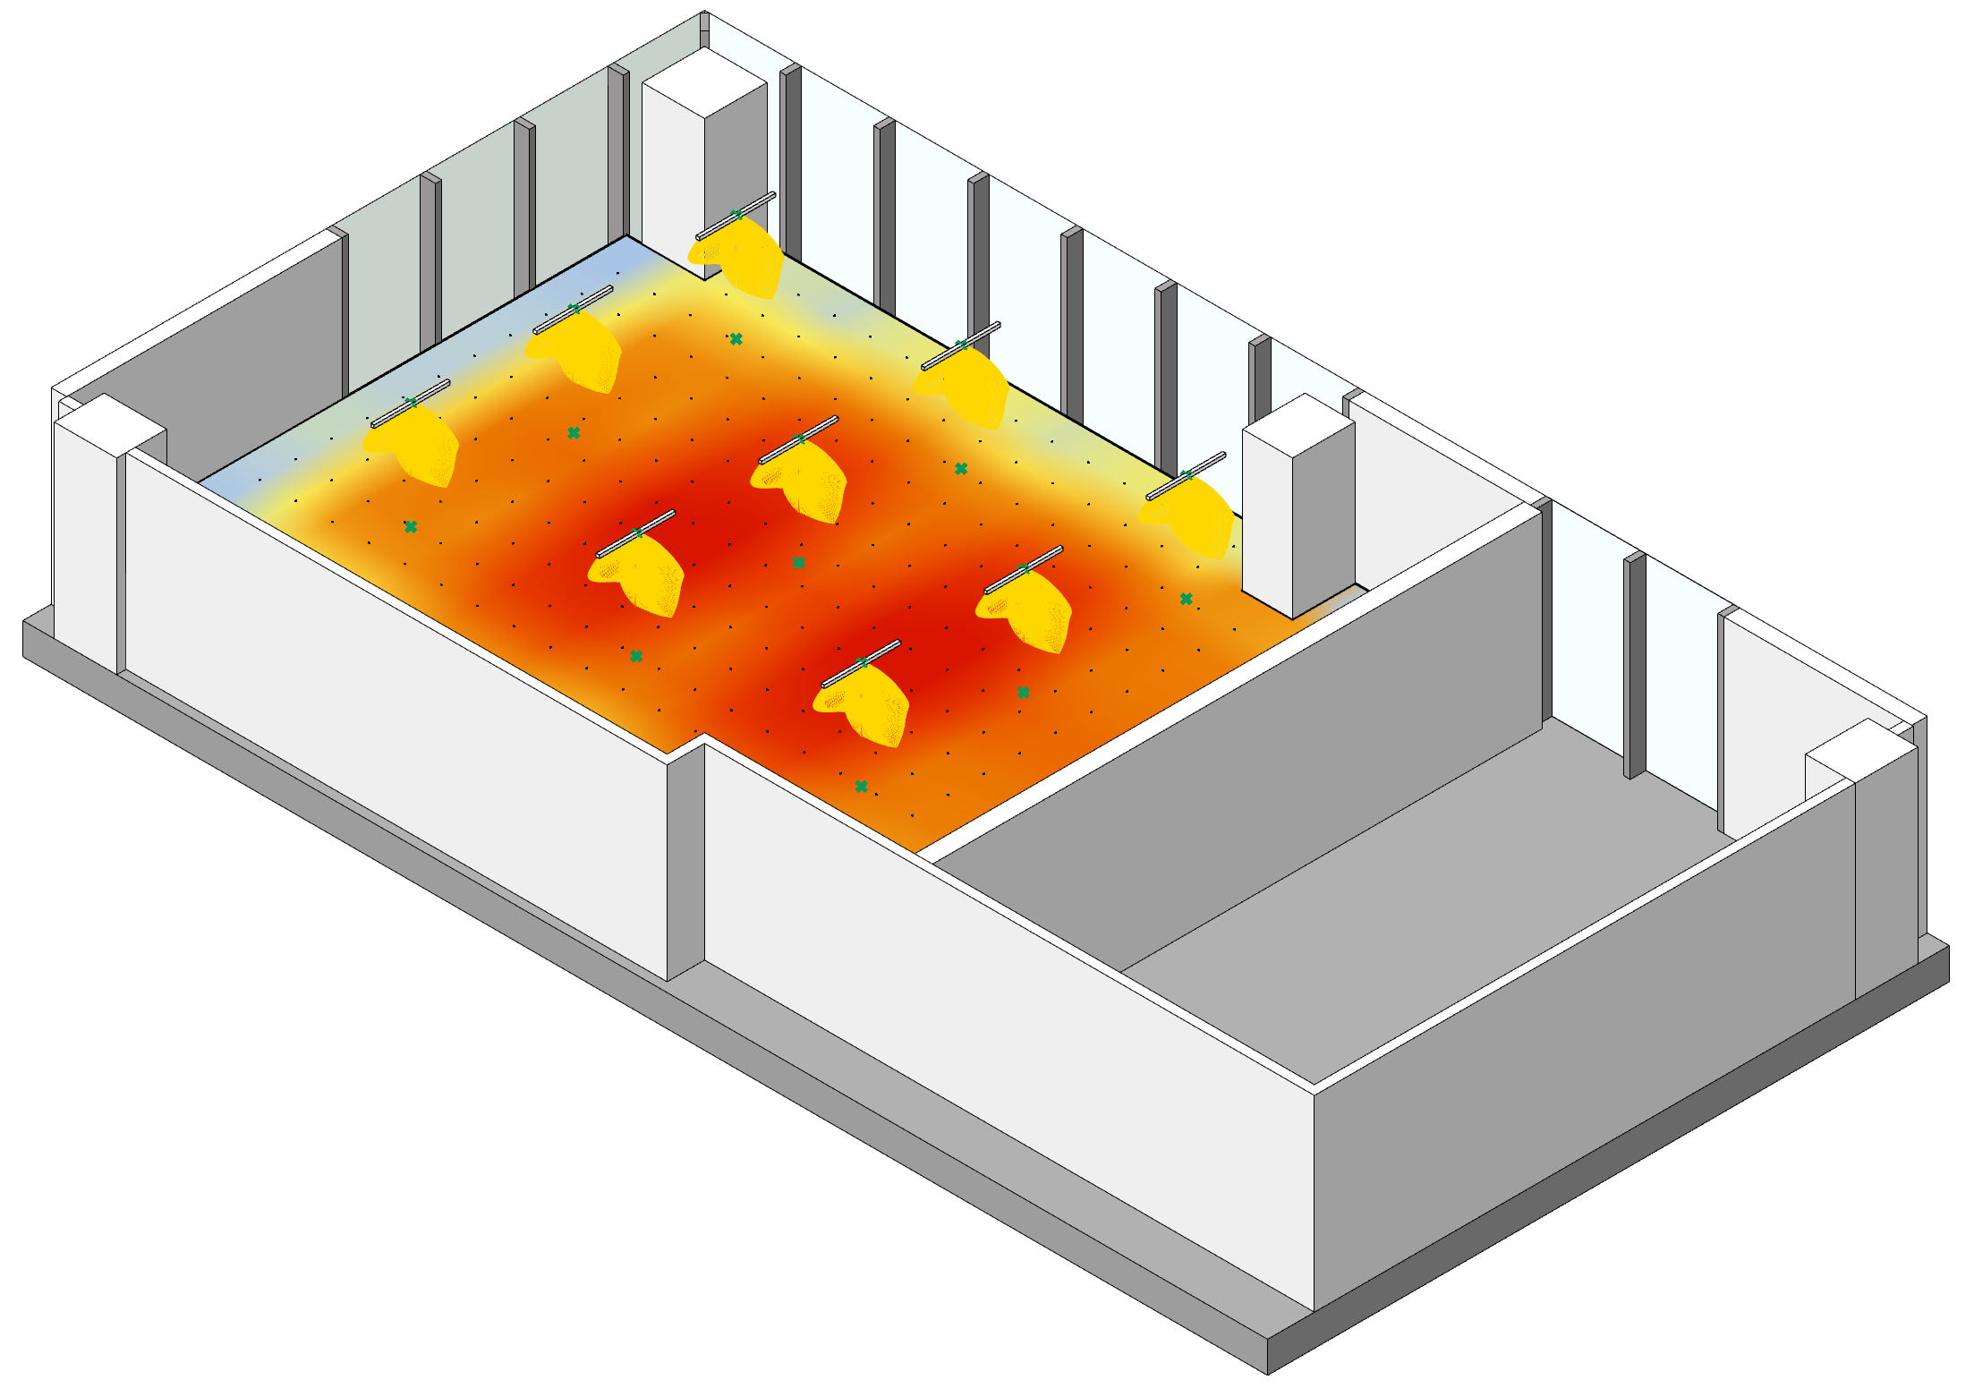

Exploratory Data Analysis & Potential Method – Optimize control strategy, Create Dataset, Train surrogate model, Apply to physical case
(c) Objective variables
Light energy consumption: The parameter that we want to be lower
Visual light comfort: Quantify from electric lighting simulation (TBD) The restriction we need to follow

Slide 8
Exploratory Data Analysis & Potential Method – Optimize control strategy, Create Dataset, Train surrogate model, Apply to physical case
(d) Optimization Galapagos Algorithm (TBD)

Slide 9
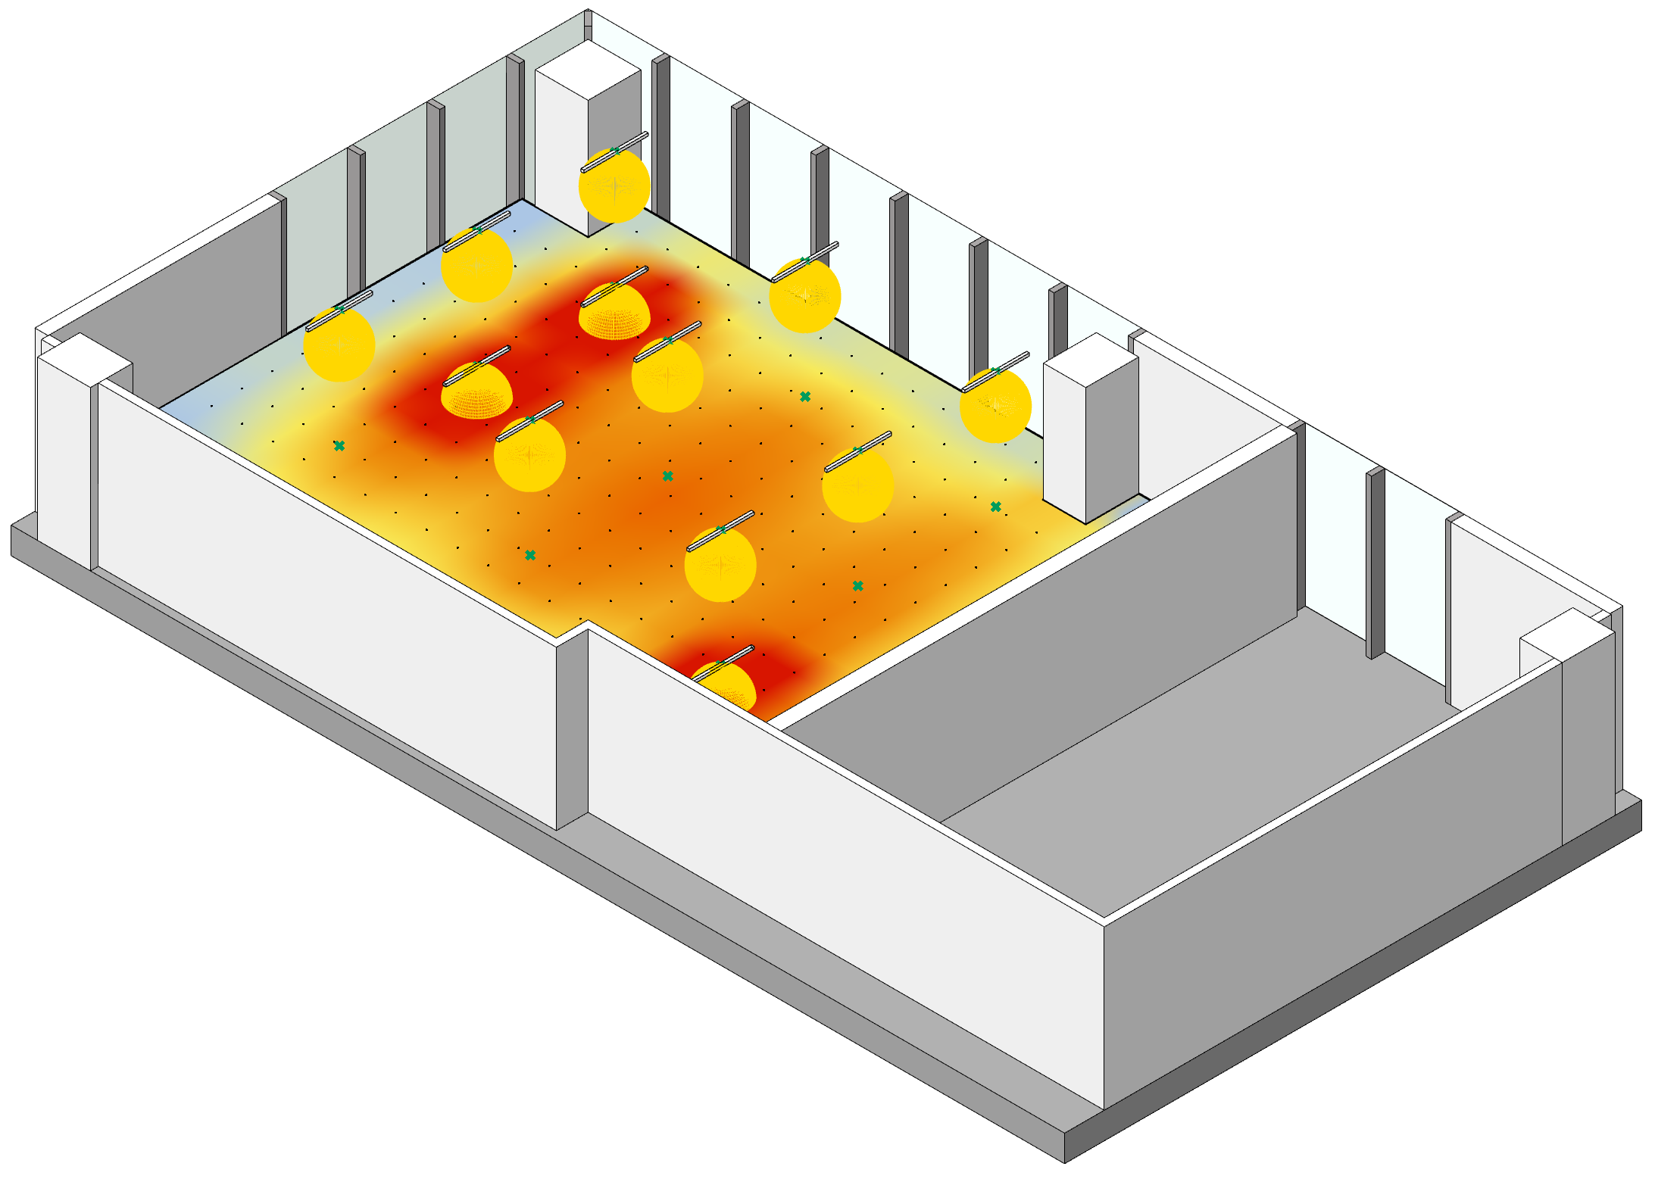
Exploratory Data Analysis & Potential Method – Optimize control strategy, Create Dataset, Train surrogate model, Apply to physical case
(e) Optimized result
The balanced light control strategy based on inputted occupant distribution

Slide 10
Exploratory Data Analysis & Potential Method – Optimize control strategy, Create Dataset, Train surrogate model, Apply to physical case
(f) Training dataset pairs
The balanced light control strategy based on inputted occupant distribution

Slide 11
Exploratory Data Analysis & Potential Method – Optimize control strategy, Create Dataset, Train surrogate model, Apply to physical case
(g) Train surrogate model
Use ML tools

Slide 12
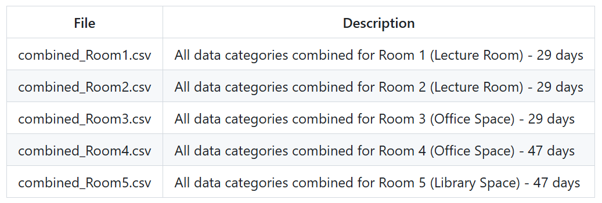
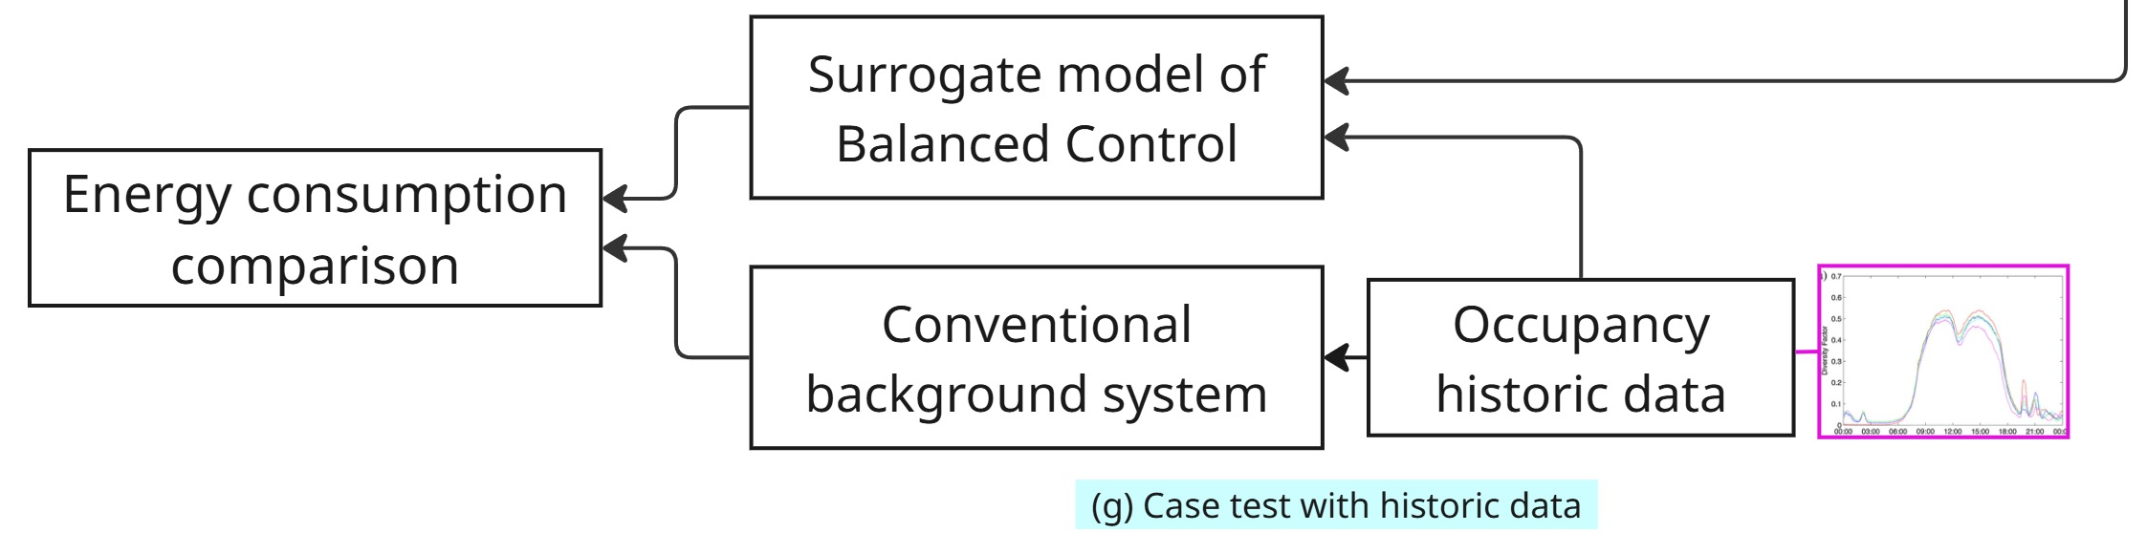
Exploratory Data Analysis & Potential Method – Optimize control strategy, Create Dataset, Train surrogate model, Apply to physical case
Average occupant count for BEE Hub on an average day. Tekler, Z.D., Ono, E., Peng, Y. et al. ROBOD, room-level occupancy and building operation dataset. Build. Simul. 15, 2127–2137 (2022). https://doi.org/10.1007/s12273-022-0925-9
(h) Case test on historical data
The occupancy data of BEE Hub (link) Then apply trained surrogate model and compare the energy performance with solely use background light

